Slide 1
Autism Detection using Eye Tracking
Sooryaprabha T S
VAS21CSCE01
Guide : Dr. Ramani Bai V
HOD, CSE Dept.

Slide 2
Contents
Abstract
Introduction
Literature Survey
Research gaps Identified
Problem Statement
Objective
Methodology
Data Description
Expected Outcome
References

Slide 3
Abstract
Autism spectrum disorder (ASD) is a developmental disability caused by differences in the brain.
People with ASD may behave, communicate, interact, and learn in ways that are different from most other people.
This project proposes to detect whether any ASD symptoms are there or not in children by showing them a video.
To confirm whether the child exhibits ASD, a questionnaire prepared by the doctors can also be used.

Slide 4
Introduction
Early detection of autism in any child could be very helpful for the parents to understand about it and they can control further worsening of autism through various medications.
ASD begins before the age of 3 years and can last throughout a person’s life, although symptoms may improve over time.
Diagnosing ASD can be difficult since there is no medical test, like a blood test, to diagnose the disorder.
Doctors look at the child’s behavior and development to make a diagnosis

Slide 5
Literature Survey
Title & Author | Year | Published by | Dataset | Method | Result
A Virtual Reality Based System for the Screening and Classification of Autism Marta Robles, Negar Namdarian, Julia Otto, Evelyn Wassiljew, Nassir Navab, Christine M. Falter-Wagner, Daniel Roth | 2022 | IEEE Transactions on visualization and computer Graphics | Data are collected for creating virtual world. | Logistic regression, support vector machine, neural network is used. | Classification accuracy is 70% to 75%.
Identification of Autism Spectrum Disorder via an Eye-Tracking Based Representation Learning Model Chen Xia, Kexin Chen, Kuan Li, Hongxia Li | 2021 | Published By ACM. | Dataset is created by studying 31 children with ASD and 43 children with TD. | SVM and CNN are used. | Classification accuracy is 93%

Slide 6
Title & Author | Year | Published by | Dataset | Method | Result
Detecting High-functioning Autism in Adults Using Eye Tracking Victoria Yaneva , Le An Ha, Sukru Eraslan, Yeliz Yesilada, and Ruslan Mitkov | 2020 | IEEE Transactions on Neural Systems and Rehabilitation Engineering | Dataset is created by conducting several experiments. | Logistic Regression is used | Using fMRI, accuracy is 71% to 86%.
Automatic Identification of High-Risk Autism Spectrum Disorder Chuangao Tang, Wenming Zheng, Yuan Zong | 2020 | IEEE Transactions on Neural Systems and Rehabilitation Engineering | Dataset for face detection is used. | Still face of kid is recorded and expressions on face are examined. SVM and KNN is used. | Children with high risk ASD is classified.

Slide 7
Title & Author | Year | Published by | Dataset | Method | Result
Machine Learning Based Autism Spectrum Disorder Detection from Videos Chongruo Wu, Sidrah Liaqat, Halil Helvaci, Sen-ching Samson Cheung, Chen-Nee Chuah, Sally Ozonoff, Gregory Young | 2020 | IEEE International Conference on E-health Networking, Application & Services | video dataset collected under the Infant Sibling Study | Recursive Feature Elimination (RFE), Ridge Regression (RR), Mutual Information Estimation (MI) and Kolmogorov Smirnov Test (KS) | 70% accuracy for smile, 68% accuracy for look face, 67% for look object and 53% accuracy for vocalization.
Diagnosis of autism using an eye tracking system Natalia I, Daniela Hidalgo, Avid Roman, Michael Power, Robert H Gilman, Mirko Zimic | 2016 | IEEE Global Humanitarian Technology Conference | Dataset contains 20 videos, how many children watched the video and how many of them not watched. | Basic image processing techniques are used. | Video-2 could easily recognise whether autism is there or not in a child.

Slide 8
Research gap identified
During the early stage of Autism, spectrum disorder in children, the works related to detection is still not progressed.

Slide 9
Problem Statement
To classify a child into either autistic or not, is challenging because there is no medical diagnosis in the early stage of Autism.

Slide 10
Objective
To detect for a child is having early stage of autism or not, along with eye tracking, and the eye movements are identified.

Slide 11
Methodology
Show video
Video segmentation
Pre-processing
Data processing & Feature extraction
Dataset creation
Video capture

Slide 12
Data Processing & Feature Extraction
Face detection
Eye Detection
Eye Movement Tracking

Slide 13
Training
Classify training data
Data cleansing
Data analysis & visualization
Data set
Test data
SVM Model
Model evaluation
Prediction
13

Slide 14
Experimental Setup
Screenshots of videos shown

Slide 15

Video 1

Slide 16

Video 2

Slide 17

Video 3

Slide 18
Data Description
The data have been collected from below institutes located in Thrissur
AMHA autism centre, near ESI hospital, Olari.
IAN Institute of Rehabilitation & Research, Muthuvara.
Helius Neuro Developmental Rehabilitation & Research Centre, Nadathara.

Slide 19
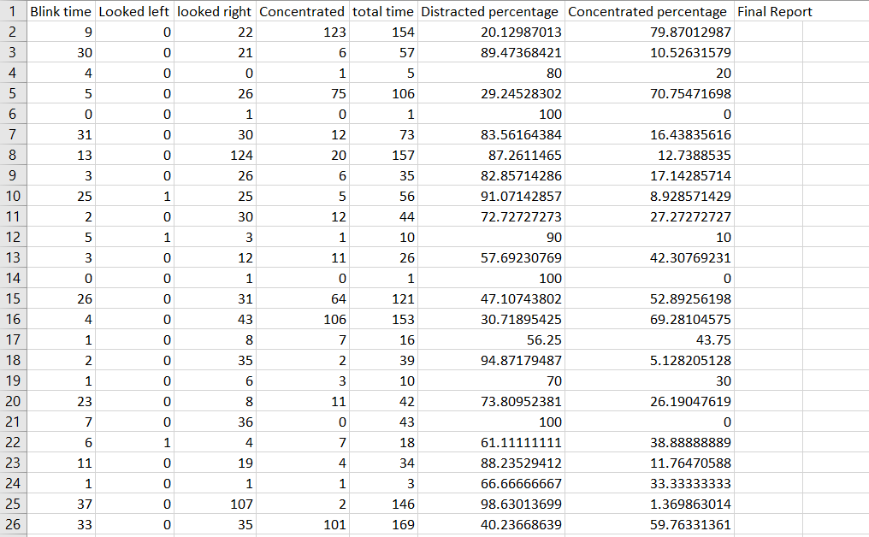

Slide 20
Blink time, looking left, looking right, concentrated are the fields that are collected. They are measured in milliseconds.
Total time, distracted percentage and concentrated percentage are evaluated using these collected data.
Total time = blink time + looking left + looking right + concentrated
Distracted percentage = ((blink time + looking left + looking right) /total time )*100
Concentrated time = (concentrated /total time )*100

Slide 21
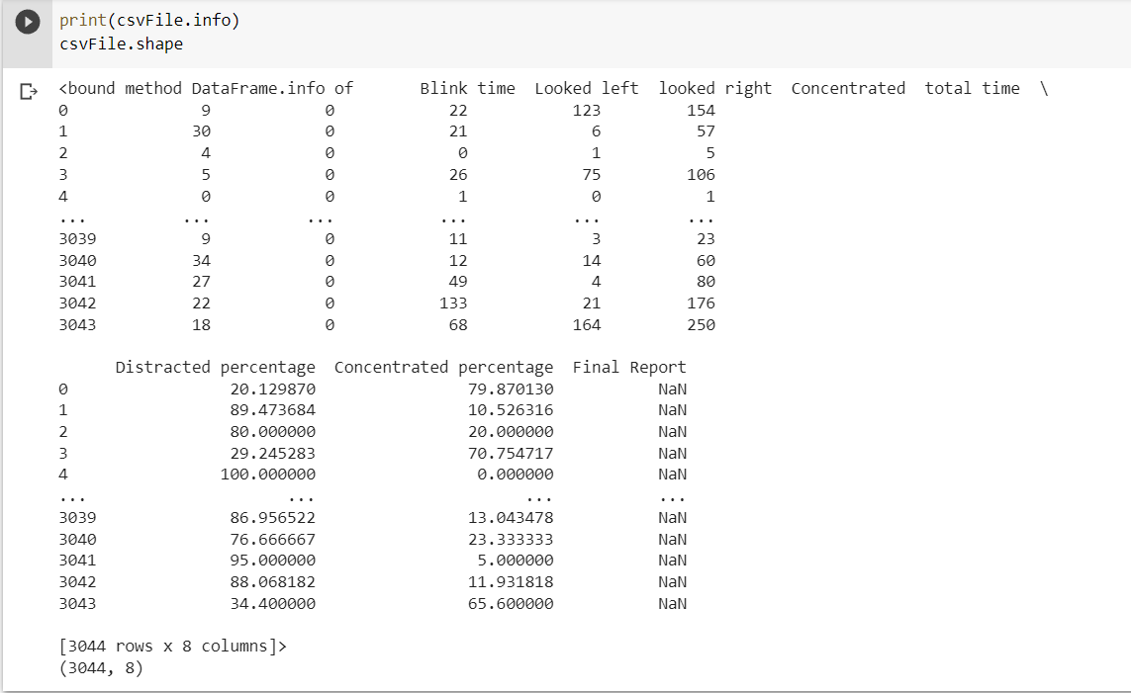

Slide 22
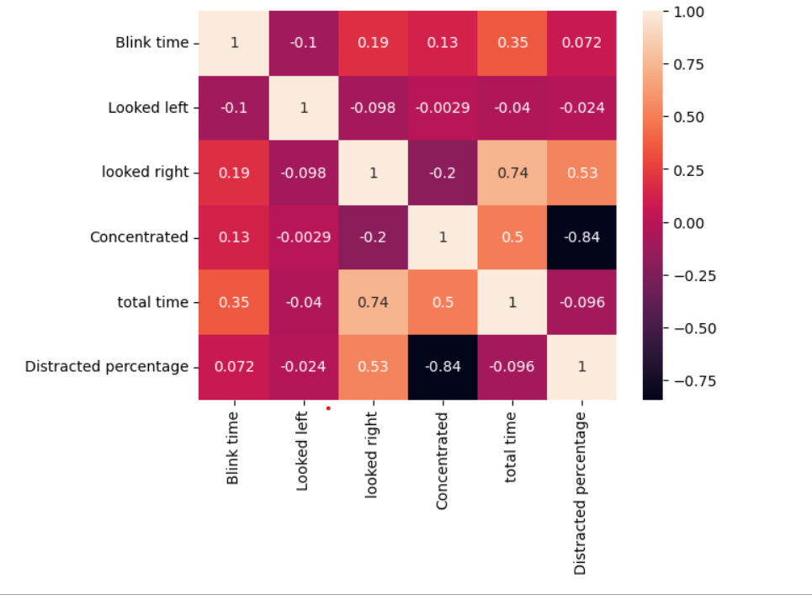
Inferences from the data

Slide 23
Results
For prediction, the support vector machine is used.
Dataset named Report is used for training.
During prediction, Report1 is generated with current details.

Slide 24
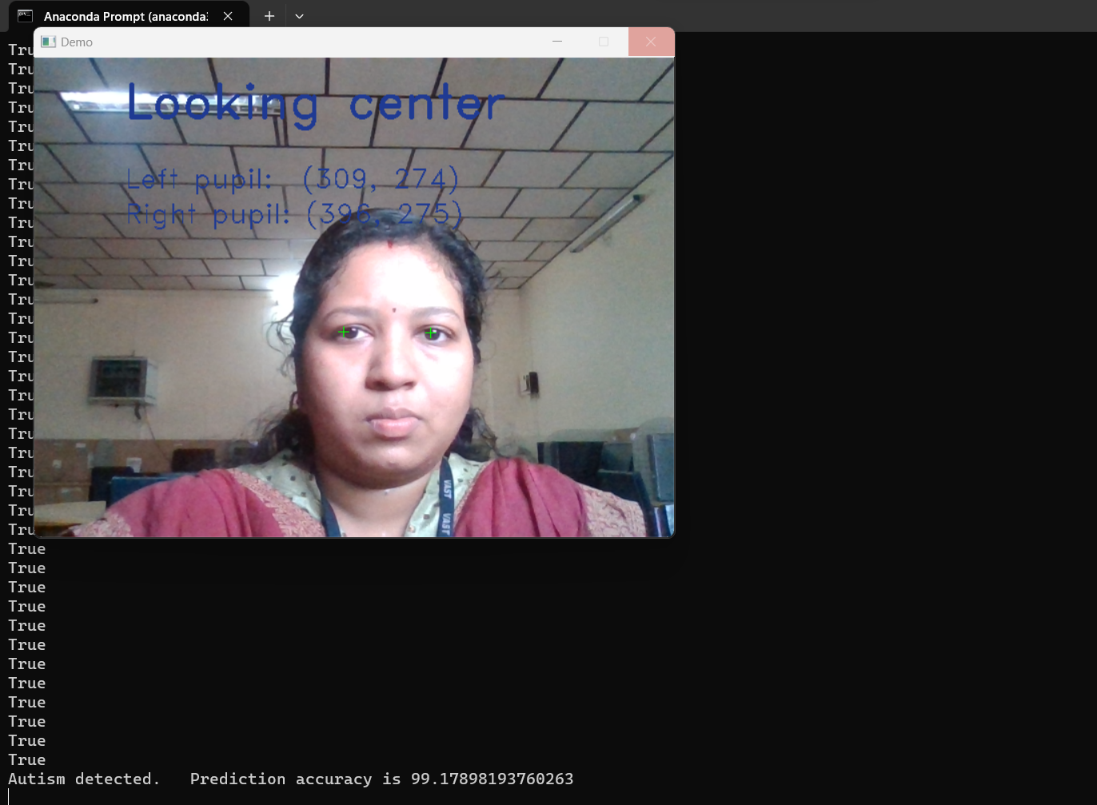

Slide 25
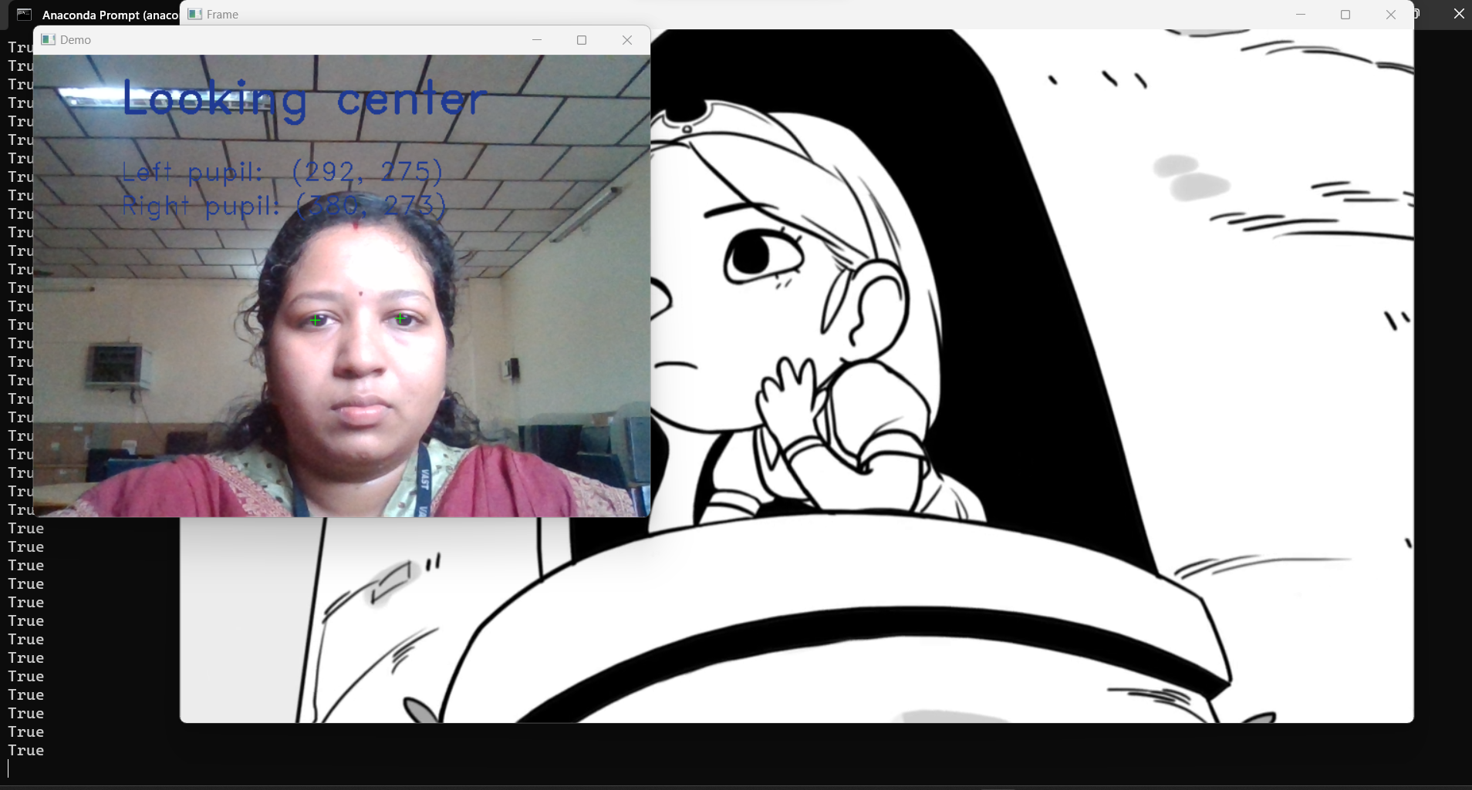

Slide 26
References
Automatic Identification of High-Risk Autism Spectrum Disorder: A Feasibility Study Using Video and Audio Data under the Still-Face Paradigm
Chuangao Tang, Student Member, IEEE, Wenming Zheng, Senior Member, IEEE, Yuan Zong, Member, IEEE, Nana Qiu, Cheng Lu, Xilei Zhang, Xiaoyan Ke, Cuntai Guan, Fellow, IEEE
Detecting High-functioning Autism in Adults Using Eye Tracking and Machine Learning
Victoria Yaneva , Le An Ha , Sukru Eraslan, Yeliz Yesilada, and Ruslan Mitkov
A Virtual Reality Based System for the Screening and Classification of Autism
Marta Robles, Negar Namdarian, Julia Otto, Evelyn Wassiljew, Nassir Navab Fellow, IEEE, Christine M. Falter-Wagner, Daniel Roth Member, IEEE
Machine Learning Based Autism Spectrum Disorder Detection from Videos
Chongruo Wu, Sidrah Liaqat, Halil Helvaci, Sen-ching Samson Cheung, Chen-Nee Chuah, Sally Ozonoff, Gregory Young

Slide 27
Thanks

